Slide 1
Segmenting Video Into Classes of Algorithm-Suitability
Oisin Mac Aodha (UCL)
Gabriel Brostow (UCL)
Marc Pollefeys (ETH)

Slide 2
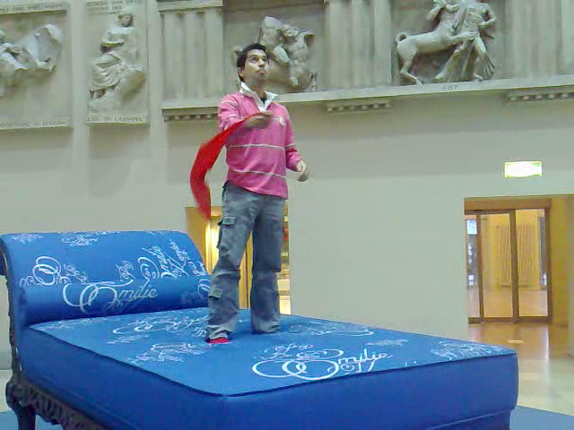
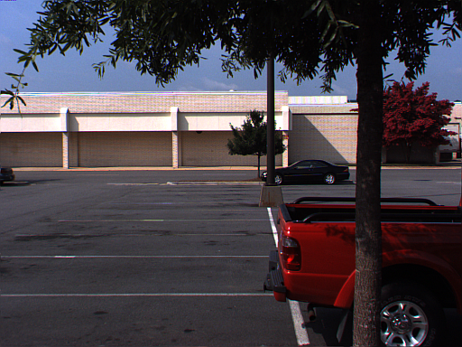
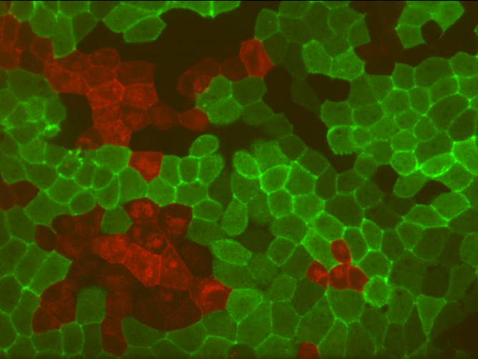
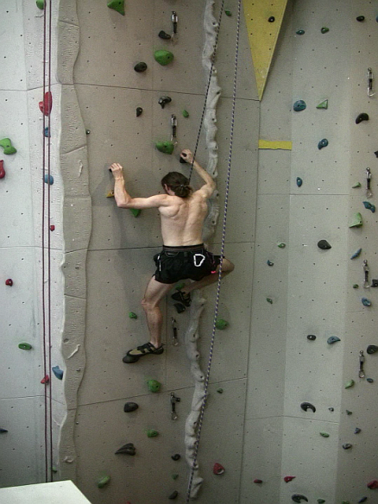
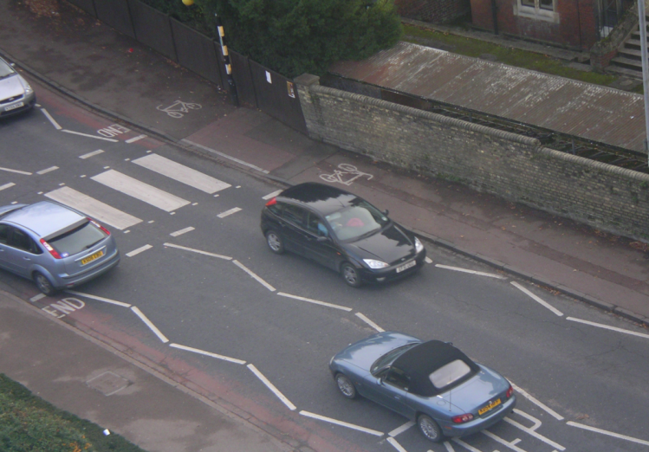
Which algorithm should I (use / download / implement) to track things in this video?
Video from Dorothy Kuipers

Slide 3
The Optical Flow Problem
#2 all-time Computer Vision problem (disputable)
“Where did each pixel go?”

Slide 4
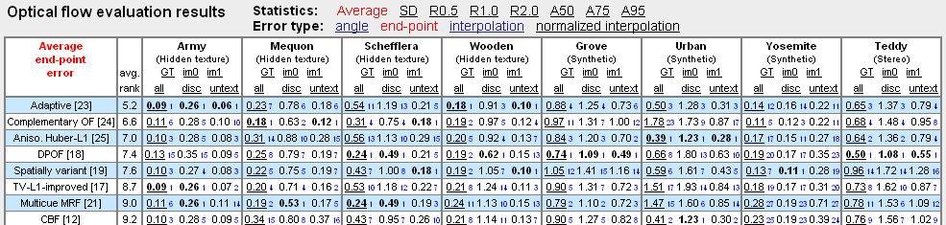
Optical Flow Solutions
Compared against each other on the “blind” Middlebury test set

Slide 5

Anonymous. Secrets of optical flow estimation and their principles. CVPR 2010 submission 477

Slide 6

Anonymous. Secrets of optical flow estimation and their principles. CVPR 2010 submission 477

Slide 7
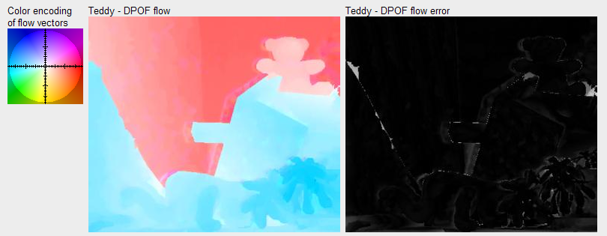

1st Best Algorithm (7th overall as of 17-12-2009)
DPOF [18]: C. Lei and Y.-H. Yang. Optical flow estimation on coarse-to-fine region-trees using discrete optimization. ICCV 2009

Slide 8
(3rd overall as of 17-12-2009) 2nd Best Algorithm
Classic+Area [31]: Anonymous. Secrets of optical flow estimation and their principles. CVPR 2010 submission 477

Slide 9
Should use algorithm A
Anonymous. Secrets of optical flow estimation and their principles. CVPR 2010 submission 477
Should use algorithm B

Slide 10
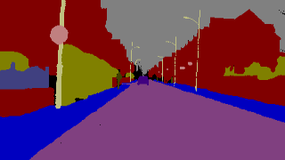
Sky
SignSymbol
Car
Building
Tree
Fence
Sidewalk
Pedestrian
ColumnPole
Road

Slide 11
Algorithm B
Algorithm A
Algorithm C
Algorithm B
Algorithm C
Algorithm B
Algorithm B
Algorithm C
Algorithm A
Algorithm D
(Artistic version; object-boundaries don’t interest us)

Slide 12
Hypothesis:
that the most suitable algorithm can be chosen for each video automatically, through supervised training of a classifier

Slide 13
Hypothesis:
that the most suitable algorithm can be chosen for each video automatically, through supervised training of a classifier
that one can predict the space-time segments of the video that are best-served by each available algorithm
  (Can always come back to choose a per-frame or per-video algorithm)

Slide 14
Experimental Framework
Groundtruth labels
Image data
Feature
extraction
Learning algorithm
Trained
classifier
Estimated class
labels

Slide 15
Experimental Framework
Groundtruth labels
Image data
Feature
extraction
Learning algorithm
New test
data
Trained
classifier
Estimated class
labels

Slide 16
Experimental Framework
Groundtruth labels
Image data
Feature
extraction
Learning algorithm
New test
data
Trained
classifier
Estimated class
labels
Random Forests
Breiman, 2001

Slide 17
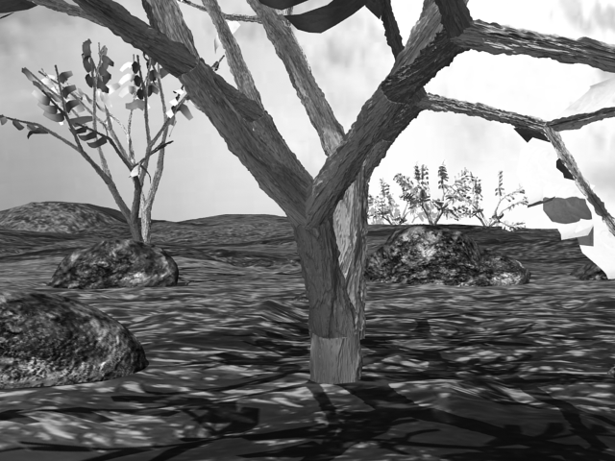
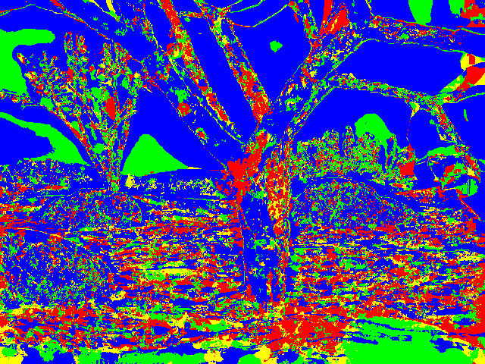
Experimental Framework
Groundtruth labels
Image data
Feature
extraction
Learning algorithm
New test
data
Trained
classifier
Estimated class
labels

Slide 18
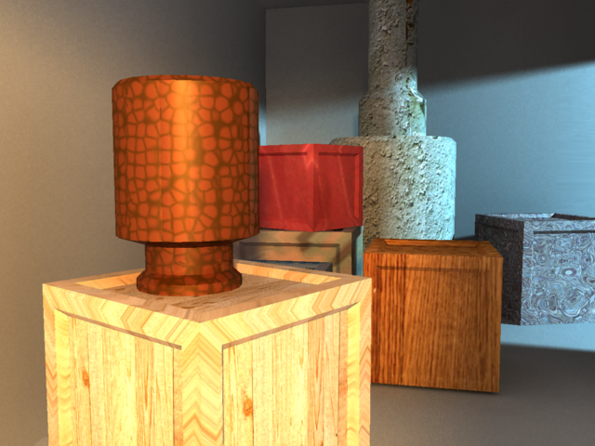
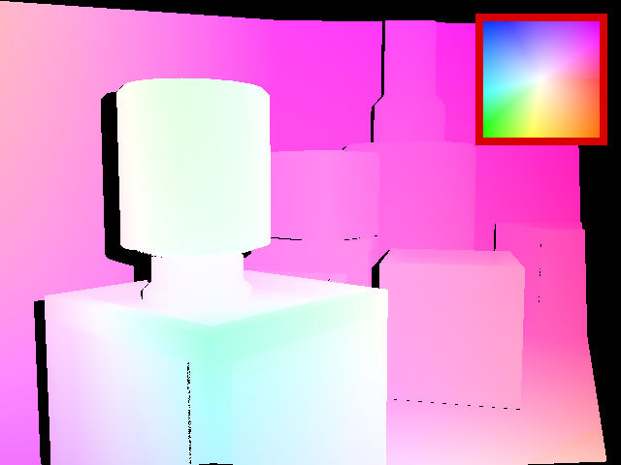
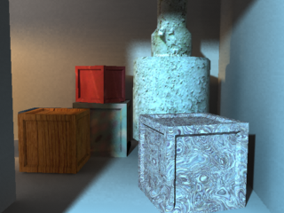
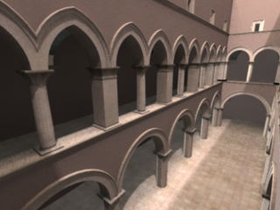
“Making” more data

Slide 19
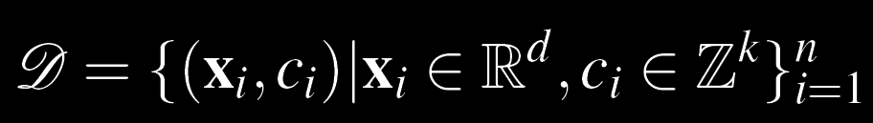
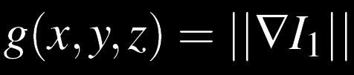


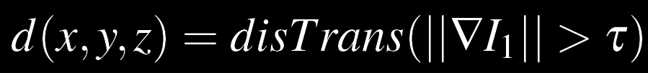
Formulation

Slide 20
Formulation
Training data D consists of feature vectors x and class labels c (i.e. best-algorithm per pixel)
Feature vector x is multi-scale, and includes:
  Spatial Gradient
  Distance Transform
  Temporal Gradient
  Residual Error (after bicubic reconstruction)

Slide 21
Formulation
Training data D consists of feature vectors x and class labels c (i.e. best-algorithm per pixel)
Feature vector x is multi-scale, and includes:
  Spatial Gradient
  Distance Transform
  Temporal Gradient
  Residual Error (after bicubic reconstruction)

Slide 22
Formulation
Training data D consists of feature vectors x and class labels c (i.e. best-algorithm per pixel)
Feature vector x is multi-scale, and includes:
  Spatial Gradient
  Distance Transform
  Temporal Gradient
  Residual Error (after bicubic reconstruction)

Slide 23
Formulation

Slide 24
Formulation Details
  Temporal Gradient
  Residual Error

Slide 25
Application I: Optical Flow

Slide 26
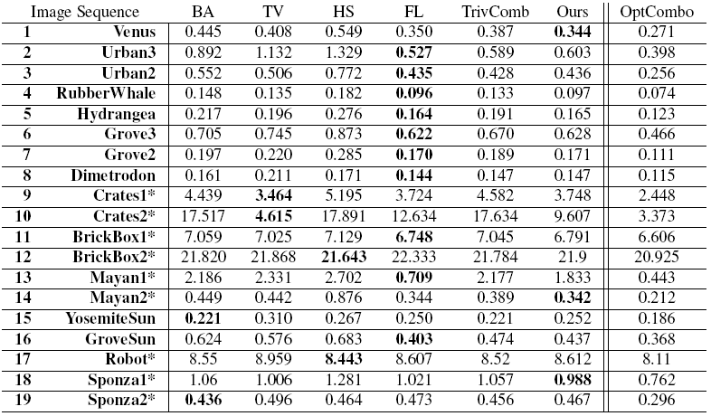
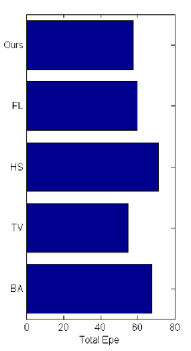

Slide 27
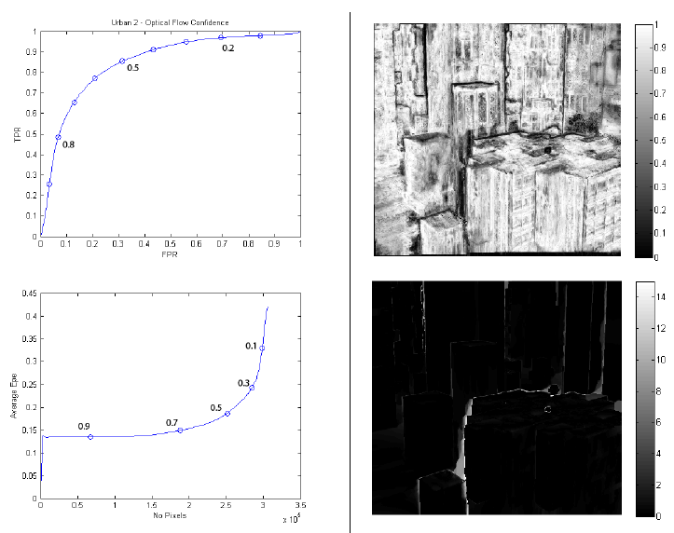
True Po-sitive Rate
FlowLib Decision Confidence
False Positive Rate (for EPE < 1.0)
Ave EPE
Number of pixels x10⁵

Slide 28
Application II: Feature Matching

Slide 29
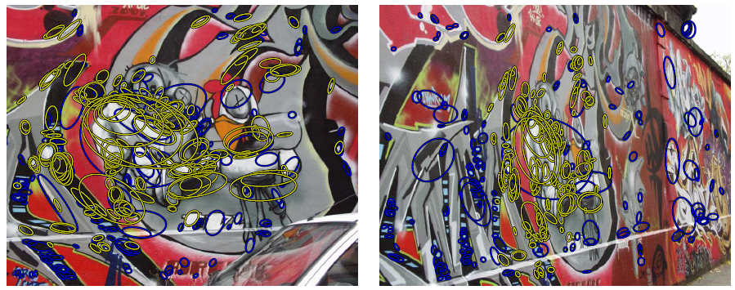
Comparing 2 Descriptions
What is a match? Details are important…
  Nearest neighbor (see also FLANN)
  Distance Ratio
  PCA
Evaluation: density, # correct matches, tolerance
“192 correct matches (yellow) and 208 false matches (blue)”

Slide 30
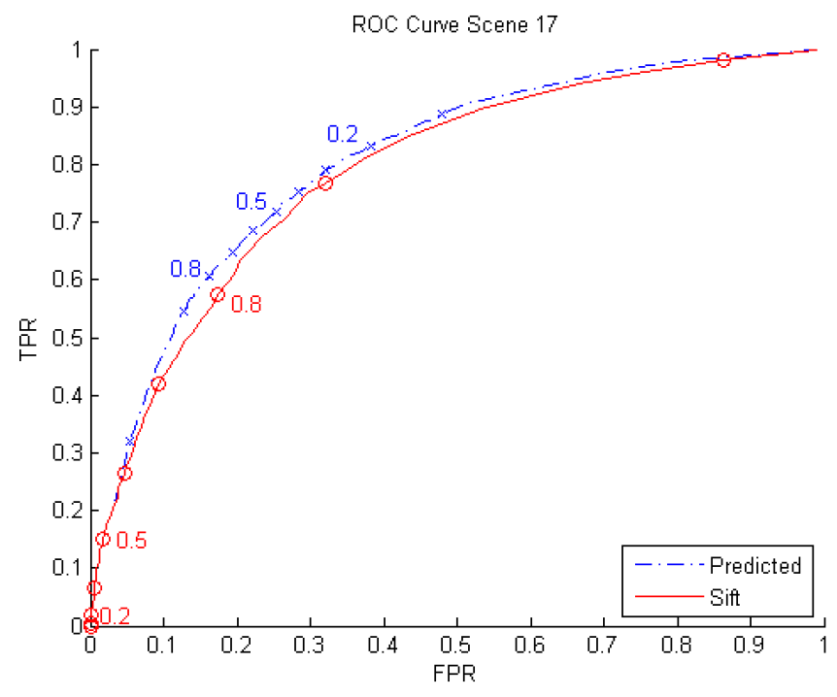
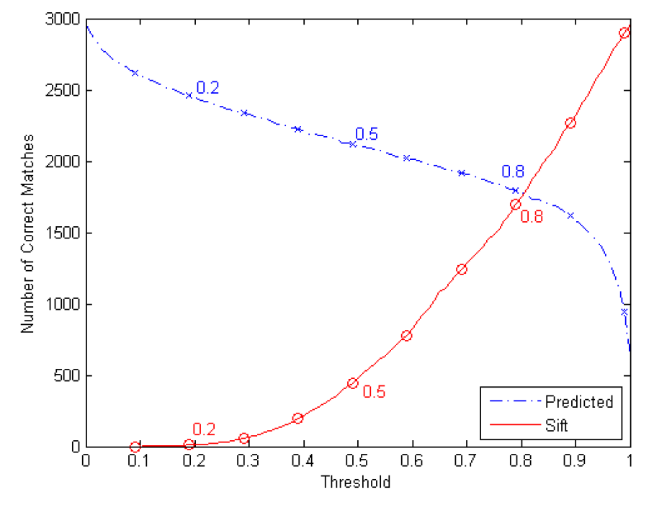
SIFT Decision Confidence

Slide 31
SIFT Decision Confidence

Slide 32
SIFT Decision Confidence

Slide 33
Hindsight / Future Work
Current results don’t quite live up to the theory:
  Flaws of best-algorithm are the upper bound (ok)
  Training data does not fit in memory (fixable)
  “Winning” the race is more than rank (problem!)

Slide 34
Summary
Overall, predictions are correlated with the best algorithm for each segment (expressed as Pr!)
Training data where one class dominates is dangerous – needs improvement
Other features could help make better predictions
  Results don’t yet do the idea justice
One size does NOT fit all
  At least in terms of algorithm suitability
  Could use “bad” algorithms!

Slide 35
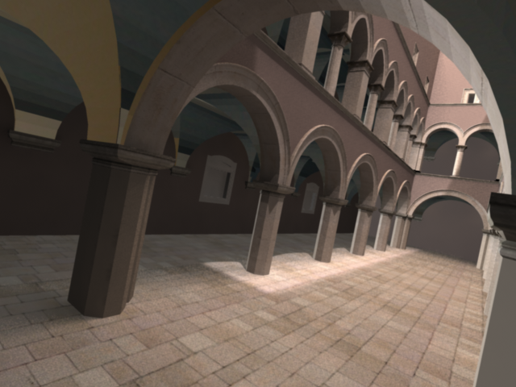
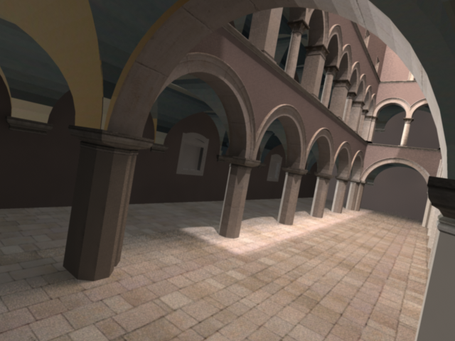

Slide 36
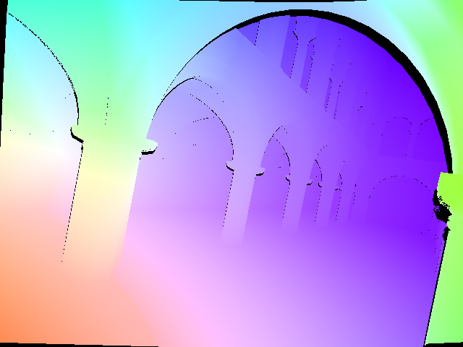

Slide 37
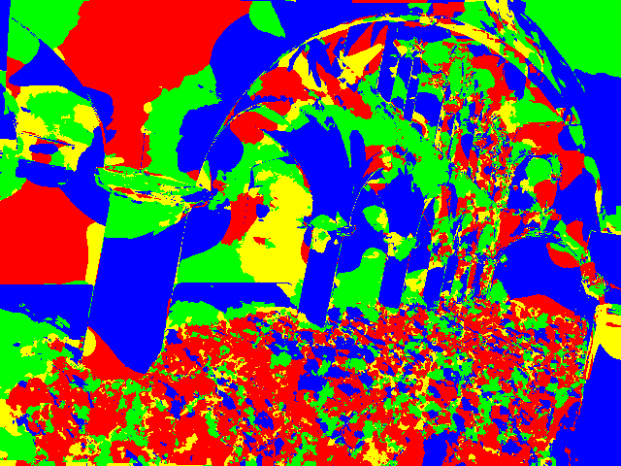
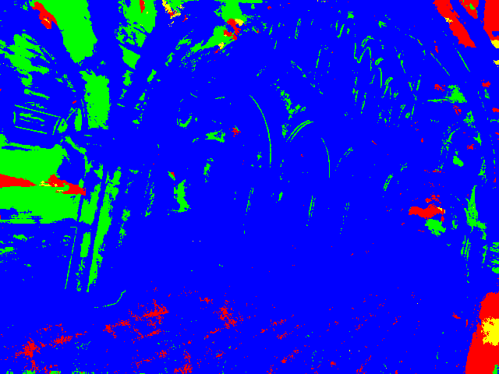
Ground Truth Best
Based on Prediction

Slide 38
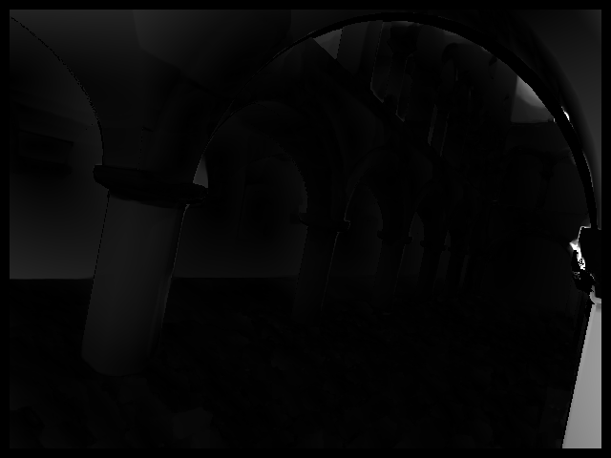
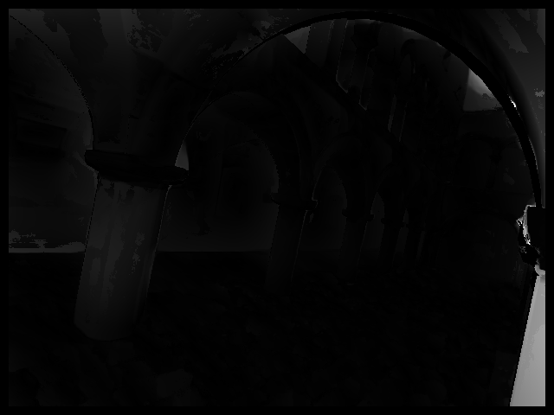
FlowLib
Based on Prediction
White = 30 pixel end point error

Slide 39
FlowLib
Based on Prediction
(Contrast enhanced)

